Slide 1
The Spreading Center of U.S.
Team: Indoorsy Aggies
Notes:
Hi we are Indoorsy Aggies. We’d like to talk about the spreading center of COVID-19 epidemic in the US.

Slide 2
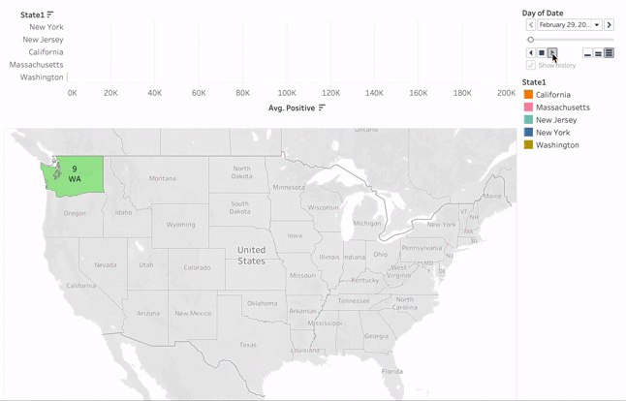
Overview
Notes:
An outbreak of COVID-19 is rapidly expanding globally.
The first confirmed case in the U.S. was reported on January 19th in Washington. Since that, the virus was detected in other states. The number of confirmed cases has risen dramatically since March.
U.S. now reports the highest number of confirmed COVID-19 cases and deaths worldwide, with New York being the hardest hitted state.

Slide 3






Overview
Notes:
The quarantines and lockdown policies are implemented to fight the spread of the virus. Public gatherings are banned, employees in most states are currently working from home and students are attending the classes online.

Slide 4

Overview
Notes:
Because COVID-19 is super contagious and can spread through breathing and talking, crowded transportation settings, such as airports, may increase chances of getting infected, so travel between states might intensify the spread of the virus across the U.S. .
According to a previous research conducted by Institutes of Medicine, travel and migration are significant characteristics of contribution to increased risk of infectious disease. Travelers were important historically in the spread of infections and remain so today, perhaps to an even greater extent (Colizza et al., 2006).
While a large number of studies focus on the severity of COVID-19 on a global scope, little has been touched on how the virus starts to spreads in the U.S. according to travel history, which might be an important indicator figuring out the spreading center of this disease.

Slide 5



Questions We Try to Answer
Which state is the spreading center of COVID-19 in the US?
How is the travel from spreading center related to the number of positive cases in each state?
What is the current stage?
Notes:
With the data of confirmed cases and travel history within the US, we try to answer three questions in this project.
First, “Which state is the spreading center of COVID-19”, and secondly, “How is the travel from spreading center related to the number of positive cases in each state”. After understanding how COVID-19 spreads across the U.S. geographically, we will try to figure out which stage the spreading center is in.

Slide 6
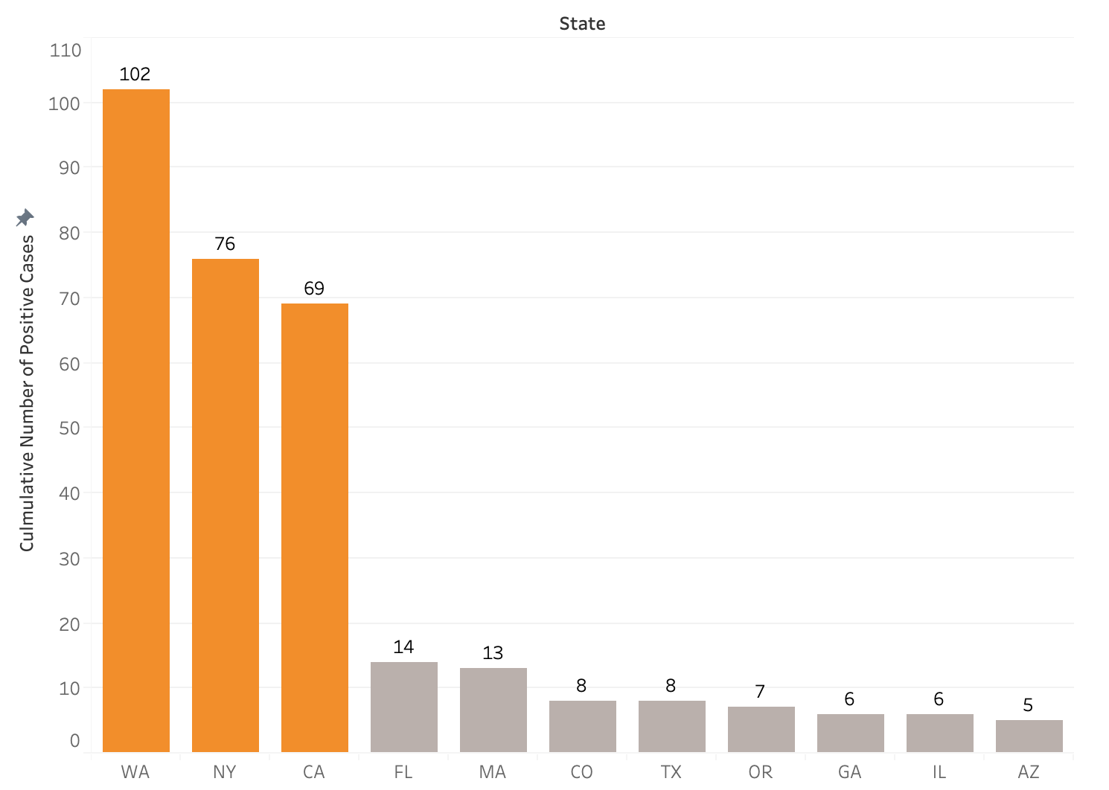
Potential Spreading Centers
March 7th
Notes:
To narrow down the potential spreading centers, we have a look at the number of each state’s cumulative positive cases on March 7th. As the graph shows, only the numbers of positive cases in California, New York, and Washington are greater than 60, while the numbers in other states are all lower than 20. Therefore, we believe only these 3 states can be potential spreading centers.

Slide 7
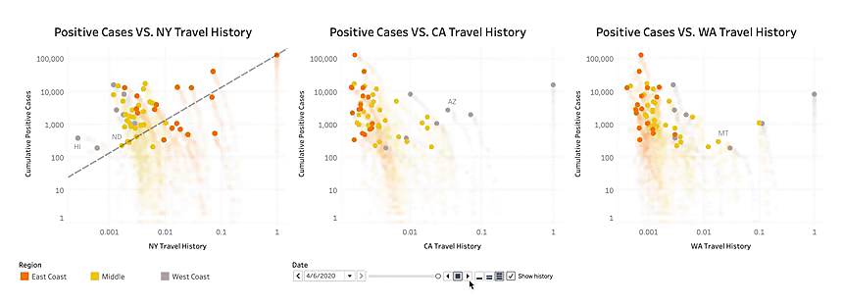
Potential Spreading Centers
Data source: https://github.com/COVIDExposureIndices/COVIDExposureIndices
Indicates motion among states based on smartphone movement data.
Notes:
Let’s look at the relationship between travel history from these three states and the number of confirmed cases in each state between March 4th and April 6th.
Take NY for example, the x axis refers to the NY travel history within the past 14 days. This 2-week time window is due to the general incubation period of coronavirus. The y axis is the cumulative number of confirmed cases by each date. And the regions are divided into east, west coast and middle. Each dot represents a state.
As we can see in the video, all dots are moving to the top left corner, suggesting that people are moving less across states and the positive cases are increasing. Differs from California and Washington, a statistically significant positive trend was observed between NY travel history and total confirmed cases, which means New York is most likely to be the spreading center of coronavirus in US.

Slide 8
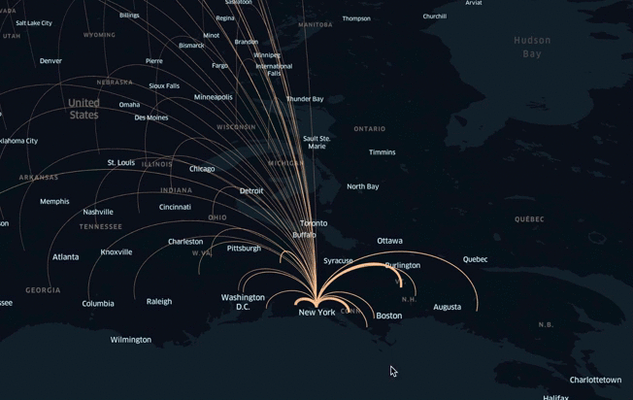
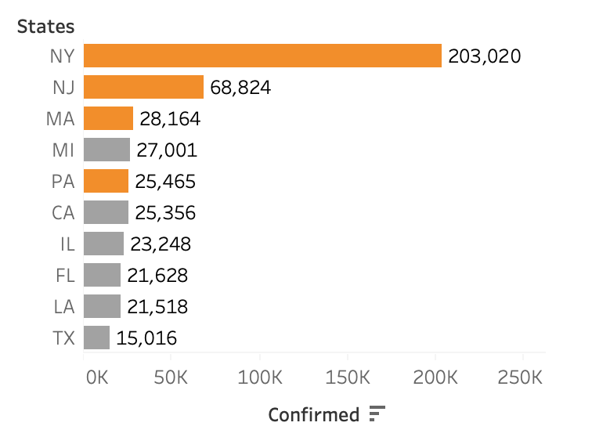
A Closer Look at NY and Its Surrounding States
States in orange bars are next to NY
Notes:
Now, let’s take a closer look at New York states and the states around New York. The orange lines in the map indicate NY travel history. The thicker a line from New York to a state, the more people travel from New York to this specific state in the past 2 weeks. From the map we can know that states surrounding New York, including New Jersey, Massachusetts, Connecticut, and Pennsylvania, have larger volume of NY travel history than the rest of US states. Interestingly, according to the latest report, these states have the most confirmed cases across the country.
From this map we can conclude that there is a correlation of travel history and the number of confirmed cases. To slow down the spread of coronavirus, we recommend strengthening the traffic control in NY and continue to encourage the “shelter in place” policy.

Slide 9
NY’s situation
Notes:
To understand what NY’s current situation is, we will compare it with Italy.

Slide 10
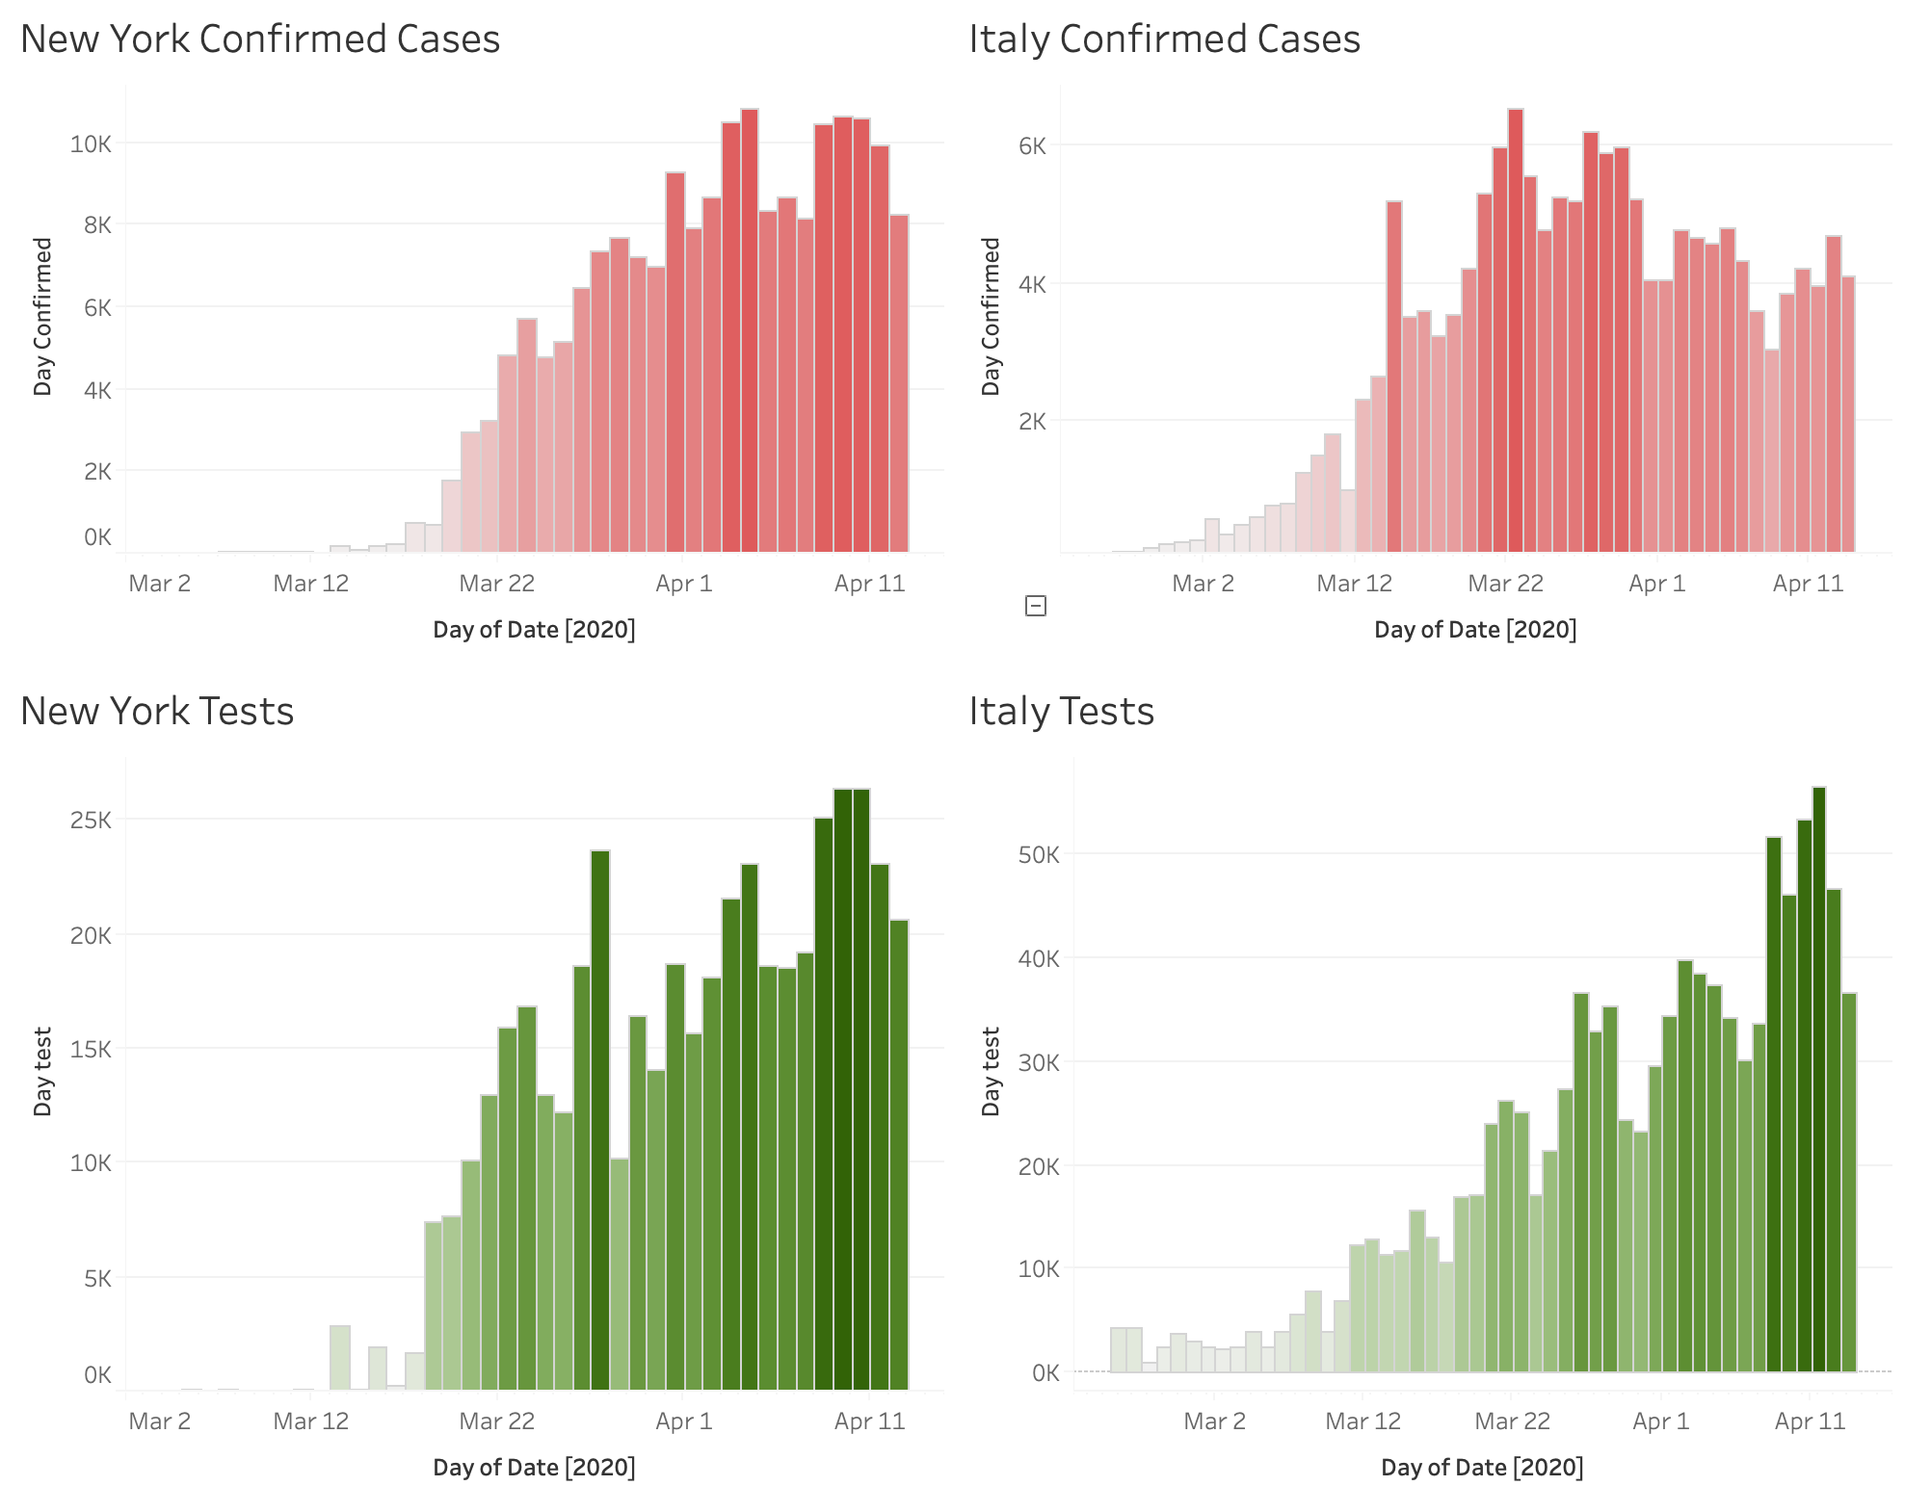
New York VS. Italy
Notes:
Italy is one of the COVID-19 worst-hit areas in the world. According to the data, daily confirmed cases tend to decrease, while testing continues to grow, suggesting that the disease in Italy remains controlled.
If the outbreak in New York follows a similar trend as in Italy, the number of newly infected cases in New York may start to decrease within several weeks, departing from the exponential trend.

Slide 11
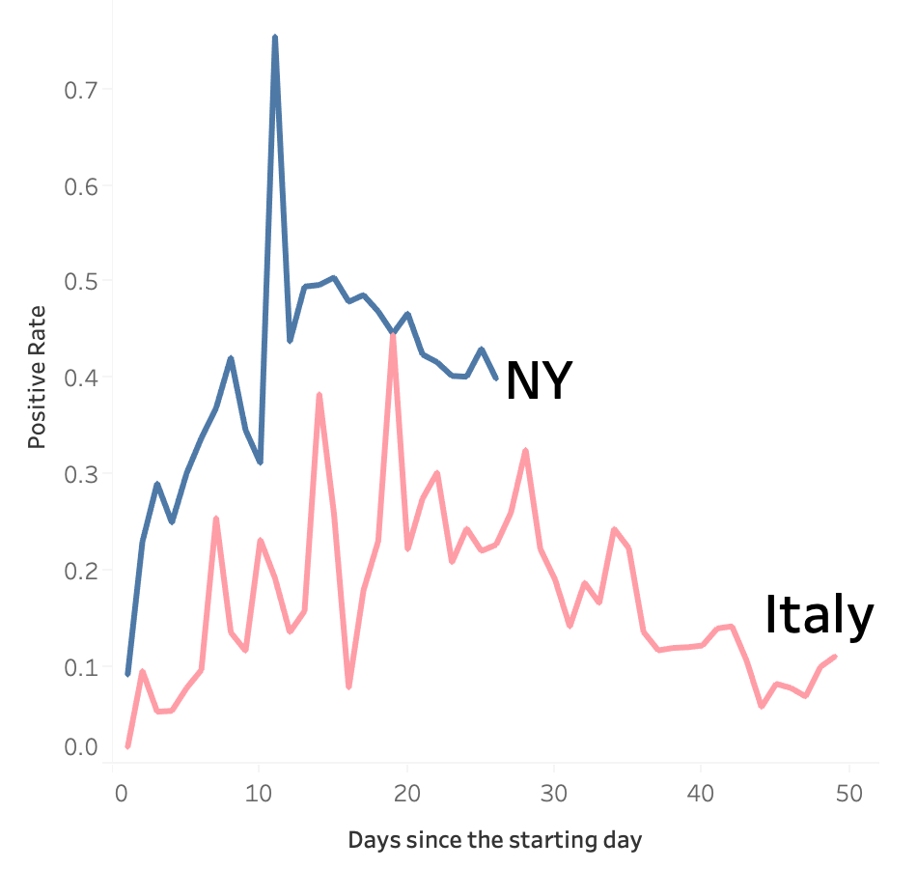


New York VS. Italy
Notes:
We choose the first day when the regions’ confirmed cases reached 0.01% of the population as the starting point, and observe the trends over time. (Day 1 in New York: Mar 18, Day 1 in Italy: Feb 25)
Although the overall positive rate in New York is higher than Italy, they basically share the similar progressing trend.
Therefore, it is possible that the trend in New York will follow a similar pattern that after 35 days since the first day, the trend will deviate from the path and become stable in the following days.

Slide 12



Summary
Recommendations
Limitations
The spreading center -- NY
Correlation between travel history and confirmed cases
Unstable situation
People should stay at home
Limit transportation
Keep quarantine until the positive rate lowers
The numbers of positive cases may be greater
Comparison with other countries may be inaccurate
Notes:
To summarize all the findings, NY is most likely to be the spreading center of COVID-19 in the U.S since NY travel history and positive cases of each state are positively correlated; Currently, the positive rate in New York remains at a very high level, indicating that the situation remains unstable.
Accordingly, we provide recommendations for the community and the policymakers. For the community: quarantine is useful and important. Please stay at home. For policymakers, they should limit transportations from the spreading center to other states and keep quarantine policy until the positive rate lowers.
Regarding limitations, states’ limited access to test kits may make the number of positive cases look smaller than they really are. Also, the future trend in NY might not be predicted based on the trend in Italy because of the big differences between them.

Slide 13
THANK YOU
Notes:
That’s all of our presentation. Thank you and stay safe!

